Slide 1
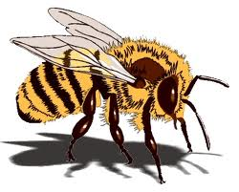
BEE New Student
Orientation 2018
Cornell University
Biological and Environmental Engineering

Slide 2
Program
Welcome and Introductions
Typical BEE and EnvE First Year Programs
Notes on Biology courses and AP Credit
Notes on Math exams and AP credit
Notes on adding and dropping Math, Physics and Chemistry courses
Advising at Cornell
Meetings with Individual Faculty Advisors

Slide 3
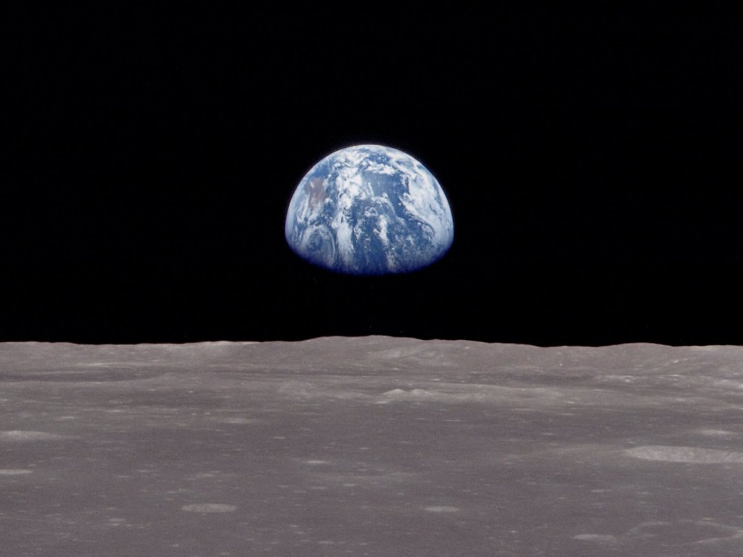
We’re all in this together
We share a common purpose
We all had help to get here
Notes:
You come here from a diversity of backgrounds but but you – along with the faculty - are all citizens of our little island in the sky.
You come here with wide range of interests and lifelong goals, but with a common purpose – to learn, to grow, to explore.
That’s what the faculty, staff and grad students are here for too so consider yourself to be among friends.
You come here as a result of your own efforts and also due to the support of your friends and the nurturing and sacrifices of your family.
That’s how we got here too. So let’s be brave and open-minded to make the opportunity of higher education into a daring adventure

Slide 4
Typical BEE Program:
Most BEE students should enroll in:
Fall 2018 | Credits |  | Spring 2019 | Credits
MATH 1910 | 4 |  | MATH 1920 | 4
CS 1112 or 1110 | 4 |  | PHYS 1112 | 4
FWS | 3 |  | FWS | 3
BIO 1350, 1440 or 1610 | 3 |  | BIO 1350, 1440 or 1610 | 3
BIO 1500 (or take in spring) | 2 |  | BEE 1200 | 1
ENGRI (or take S18 or F19) | 3 |  | BIO 1500 (or in the fall) | 2
PE |  |  | PE
TOTAL CREDITS | 17-18 |  | TOTAL CREDITS | 16-18
AP credit can cover all 8 required credits of first-year bio,
including lab, except for pre-meds
First year CALS students may not exceed 18 credits of academic coursework

Slide 5
Typical EnvE Program:
Most EnvE Students should enroll in:
Fall 2018 | Credits |  | Spring 2019 | Credits
MATH 1910 | 4 |  | MATH 1920 | 4
CS 1112 or 1110 | 4 |  | PHYS 1112 | 4
FWS | 3 |  | CHEM 1570 or Bio | 3
CHEM 2070 | 4 |  | FWS | 3
ENGRI (or take S18 or F19) | 3 |  | BEE 1200 | 1
PE |  |  | PE
TOTAL CREDITS | 15-18 |  | TOTAL CREDITS | 15
AP credit can cover the 3 required credits of first-year bio,
typically taken in 2nd year, except for pre-meds
If taking Chem 2070, go to http://chemlabs.arts.cornell.edu/discussions.cfm
to change labs or enroll in the discussion section
First year CALS students may not exceed 18 credits of academic coursework

Slide 6
First Year Bio and
Bio AP Credit in BEE/EnvE
AP | Premed | BioEng | EnvEng
AP Score of 5 = 8 credits | BIOG 1350 | choose 2 of the 3 following | choose 1 of the following
(You’re done!) | BIOG 1500 | BIOMG 1350 | BIOEE 1610
Premeds, take a bio lab | BIOMG 1440 | BIOG 1440 or (1445+1045) | BIOMG 1350
later (e.g. microbiology lab) | BIOMG 1445+1045 | BIOEE 1610 | BIOEE 1780
 |  | plus | BIOG 1440
AP Score of 4 = 4 credits |  | BIOG 1500 (lab) | BIOG 1445+1045
Take a 3 credit lecture |  | or | or
and BioG 1500 |  | BIOG 1107/1108 (summer) | BioG 1107 (summer)
BioMG 1350 Principles of Cell and Developmental Biology (F, S, Su)
BioG 1440 Introduction to Comparative Physiology (F, S, Su)
BioG 1445 Autotutorial BioG 1440 w/lab. Use caution & the help course.
BioEE 1610 Ecology and the Environment (F, S, Su)
BioEE 1780 Evolution and Diversity (F, S, Su, DL) - for EnvE’s only
BioG 1107/1108 offered summer only: 8 credits including lab

Slide 7
Math AP credit and
Math placement exams
Math BC Score 4 or 5: 4 credits of Math 1910... BUT:
  We strongly recommend Math 1910 anyway
  High school AP calculus ≠ Cornell engineering calculus
  Math 1920 requires in-depth, rapid recall of Math 1910 material
  Math BC score 4: Much poorer outcome in 1920 than a 5 or Math 1910
  You must attempt the Engineering placement exam before enrolling in 1920. Those who took it, THANK YOU! Passing was 43 out of 70
Summer Online Math Diagnostic
  If a supplemental course was recommended or required, discuss your summer math experience with your advisor
Math Placement Exams during Orientation (yesterday)
  Engineering Exam: places you out of Math 1910 or 1920
  Math Department Exam: places you out of Math 1110 into 1910
  Did you miss the exam? Discuss with your advisor.

Slide 8
The Ins and Outs of
Adds and Drops
Math, lectures and sections
  Use studentcenter.cornell.edu to add or drop courses
  If openings exist, tweak your schedule. If everything’s filled, more will be added.
Freshman Writing Seminars and Biology: Use student center
Chemistry, lectures and labs
  Do NOT use Student Center Add/Drop website: visit
  http://chemistry.cornell.edu/courses/add-drop.cfm and join a wait list
  Attend your first lab on time, or your spot will go to a wait-listed student
  If wait listed: Show up in person to claim an open slot, see directions
  Don’t forget the CHEM 2070 discussion section signup
Physics:
  Try Student Center first, then visit the Physics course coordinators
  “Swap” feature does not work... It will drop the whole course.

Slide 9
Now that you’re part of Cornell…
What do you most look forward to in this first year?
What do you anticipate as your greatest challenge this year?

Slide 10
Advising at BEE
?
?
?
?
?
?
Notes:
What is advising at BEE all about? It’s a system of resources, a constellation of resources, to help you succeed here. First of all, not every day will be sunny and bright. The little cloud in the corner of your attention may take up a spot right over your head and rain questions on you.

Slide 11



What to do?
Notes:
When (not if, when) this happens, what should you do? Just tough it out with a poker face? No. Just hide and make believe you’re anonymous? No. There is a better way.

Slide 12

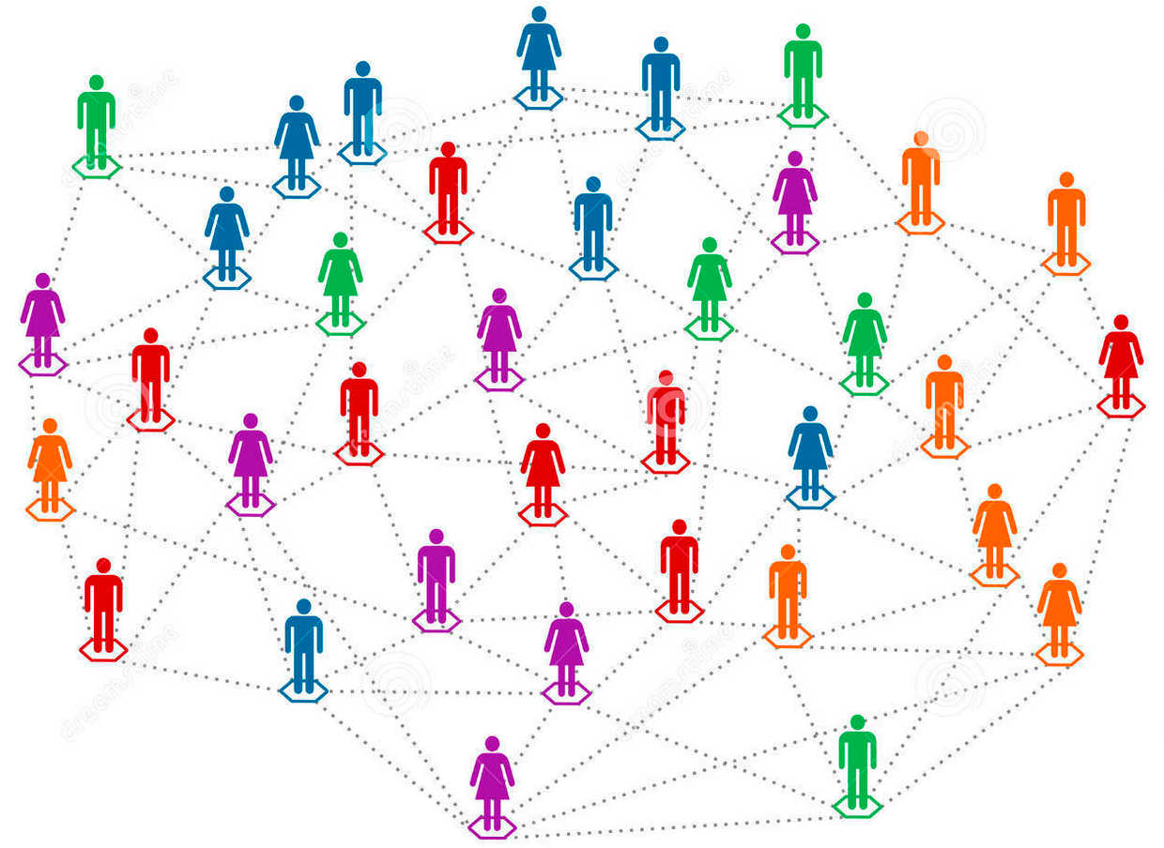
Advising at BEE
Student Counseling
Gannett
Ms. Brenda
Marchewka
207 RR
CALS advising
140 Roberts
?
?
?
?
?
?
Prof. Jean
Hunter
207 RR
Engineering Advising
167 Olin
Your Faculty
Advisor
Notes:
Cornell has the resources to answer all – or to be honest, nearly all – the questions that plague you. Your first stop should be your academic advisor – and you’ll be meeting that person today. Your advisor will sign forms for you, give you advice on course choices and career questions, and advocate for you if you are in a tight spot – or will help you find the right resources to address your question.
Those little smiley faces are your classmates, dorm neighbors, TA’s, and friends here at Cornell. And you can also ask for advice from your network of family, friends and mentors back home.

Slide 13
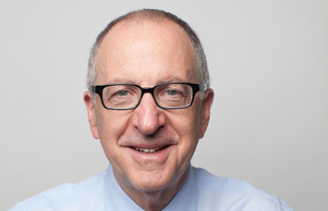
Campus Resources
“If you learn anything… please learn to ask for help. It is a sign of wisdom and strength.”
-David Skorton, 12th President of Cornell University
Notes:
Think about this: Why would a student NOT ask for help? What does it say about someone – you maybe - that they decide to ask for help? Does it say that you weren’t smart enough to get it on your own, or does it say that you recognized a situation where two heads are better than one, an opportunity to get a second opinion or acquire new insight? What does your answer say about your assumptions concerning your own intelligence and talent? Do you have a growth mindset or a fixed mindset?
In a fixed mindset, people believe that their basic qualities, like their intelligence or talent, are simply fixed traits, unchangeable. They also believe that the hallmark of talent is continuous success without significant setbacks. People stuck in a fixed mindset feel defeated if they don’t succeed in something on the first try. They think of temporary setbacks as failures and feel miserable about them. Sometimes they try to protect themselves from situations where they might encounter difficulty, or try to hide any frailties from others, even though the only one judging them is themselves. They spend their time documenting their talent instead of developing it. Advertising it instead of extending it. And their error, the fixed mindset, limits their potential and makes it hard for them to be truly successful and satisfied in the long run.
In a growth mindset, people believe that their most basic abilities, their most fundamental traits – all forms of intelligence and talent from academics to arts to physical fitness to willpower to social interaction - can be developed by orders of magnitude through persistence and hard work. This view fosters a love of the learning process with all its bumps and blind ends, and a resilience that is essential for great accomplishment.
The passion for stretching yourself and sticking to it, even (or especially) when it’s not going well, is the hallmark of the growth mindset. This is the mindset that allows people to thrive during some of the most challenging times in their lives.

Slide 14
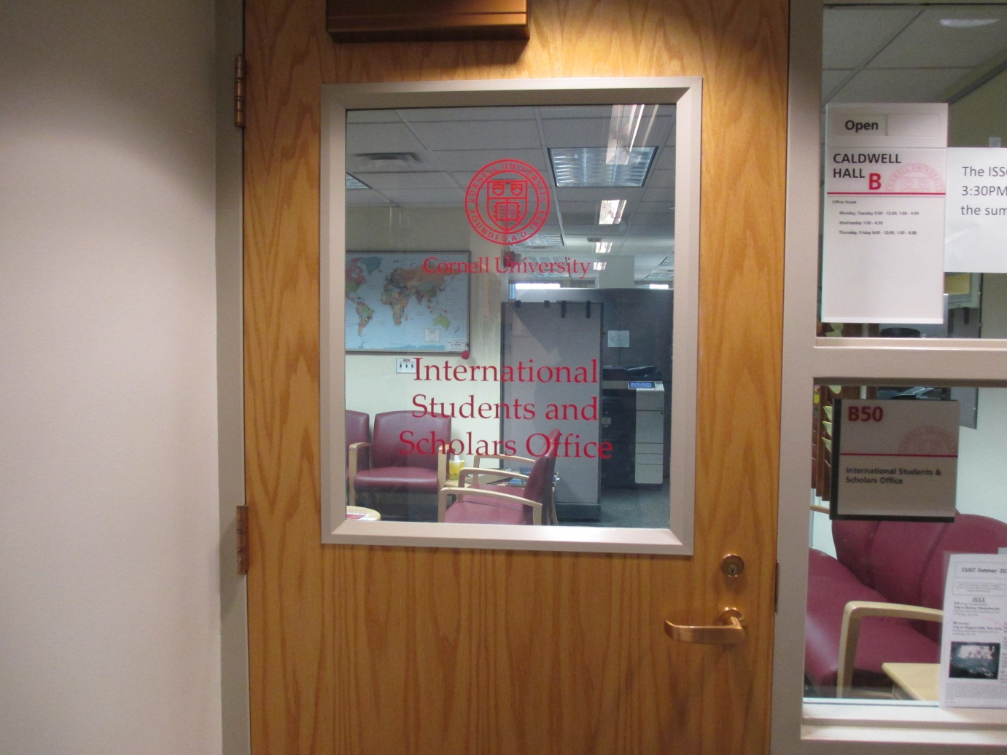
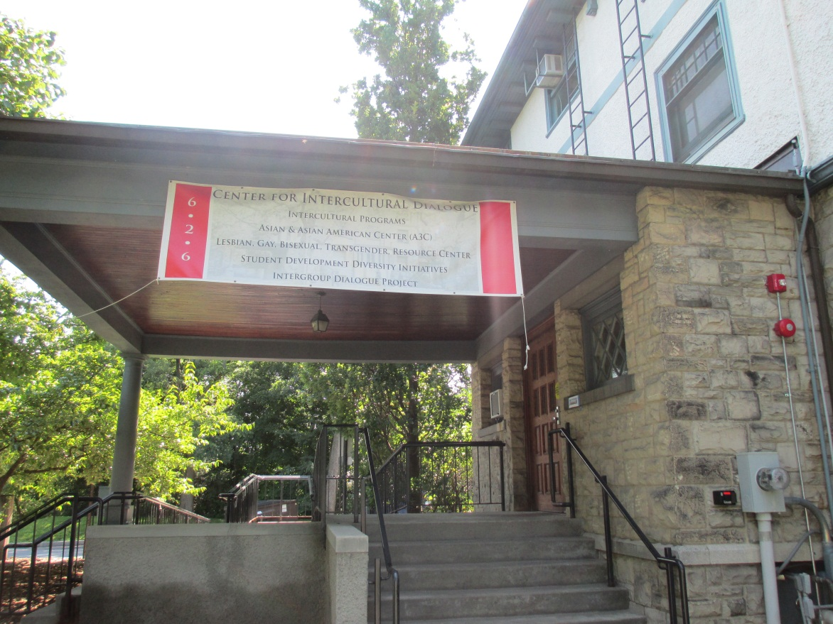
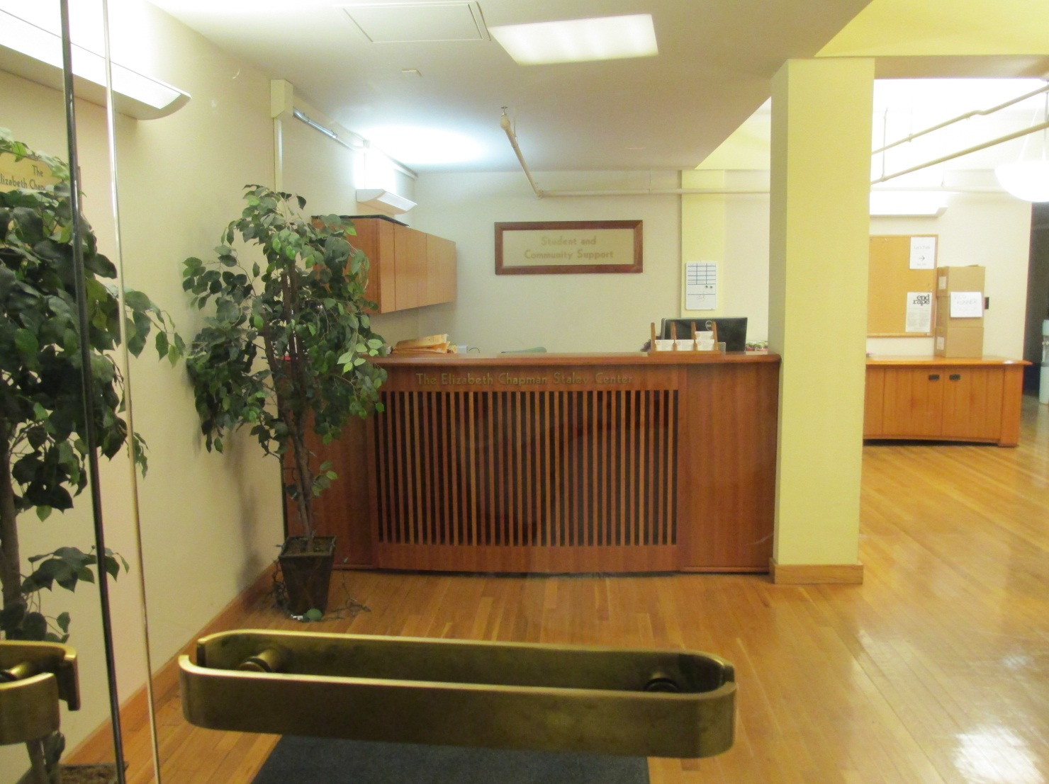
Other support services:
Cornell Center for Intercultural Dialogue & LGBT Resource Center - 626 Thurston Avenue
Dean of Students & Office of Student Support: 200 Willard Straight Hall &
EARS, 213 WSH
International Students and Scholars Office
B-50 Caldwell Hall
Notes:
Besides the support opportunities on the last pages, here are some more that may be helpful for specific issues you or your friends may be confronting.

Slide 15
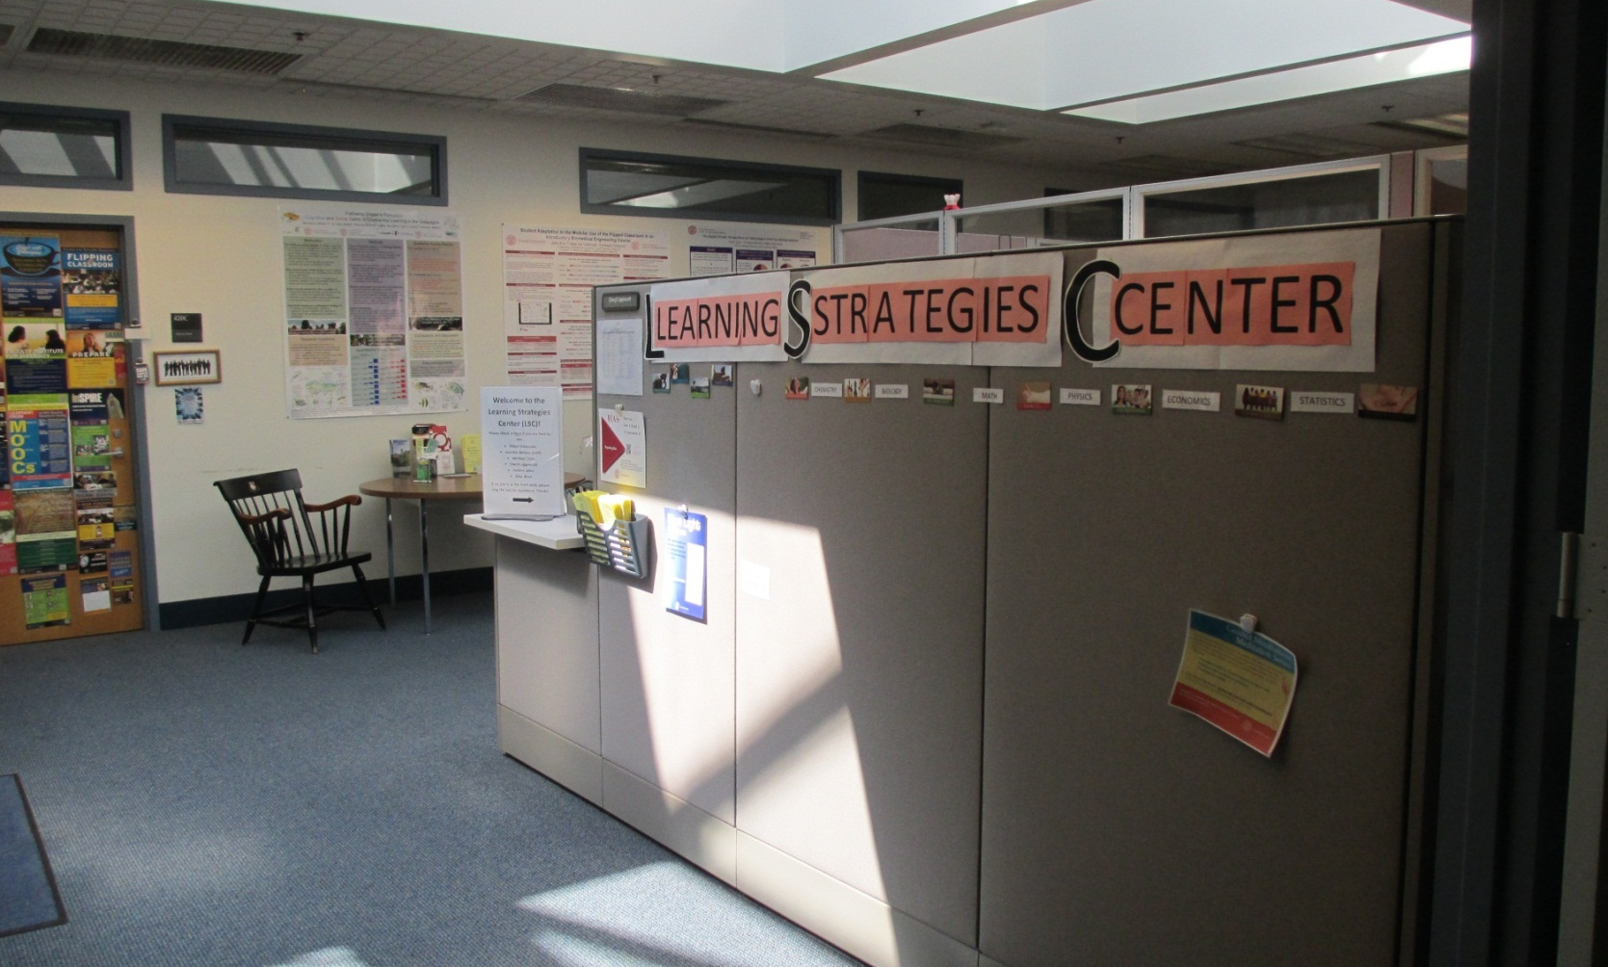
Learning Strategies Center
420 CCC
Supplemental courses, workshops, tutoring, study skills resources
Notes:
Brain plasticity/growth mindset

Slide 16
ALS 1700 Maximizing Individual Success
7 week class, August 23 – October 12, Monday/Wednesday, 10:10 – 11:00 am
Location: B02 WARREN HALL
Designed to provide information and skills to thrive at Cornell; not just survive. Students learn about different ways to think about studying, managing time, identify strengths, and keep healthy, and build networks in order to improve their transition to college.
Instructors: Jed Sparks, Jennifer DeRosa, Lisa Ryan, Cate Thompson
Notes:
You are invited to to visit this course which is about academic and career resources at Cornell, mainly in CALS, how to navigate these resources, as well as time management and interview skills.
We do some of the planning and job search activities in BEE 1200 but if you want this right away, and have room in your schedule, CALS invites you to check it out.

Slide 17
Questions?
(ask away!)

Slide 18
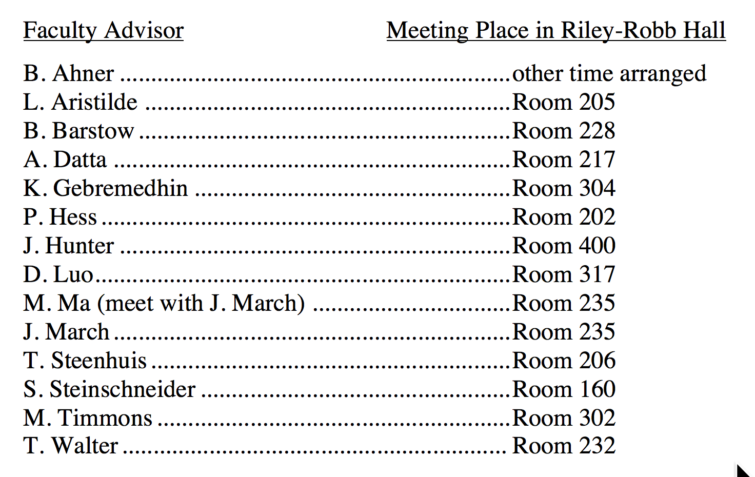
Faculty Advisor Meetings in Riley-Robb Hall
Faculty Advisor Meeting Place in Riley-Robb Hall
B. Ahner other time arranged
L. Aristilde Room 205
B. Barstow Room 228
A. Datta Room 217
K. Gebremedhin Room 304
P. Hess Room 202
J. Hunter Room 400
D. Luo Room 317
M. Ma (with J. March) Room 235
J. March Room 235
T. Steenhuis Room 206
S. Steinschneider Room 160
M. Timmons Room 302
T. Walter Room 232

